Slide 1

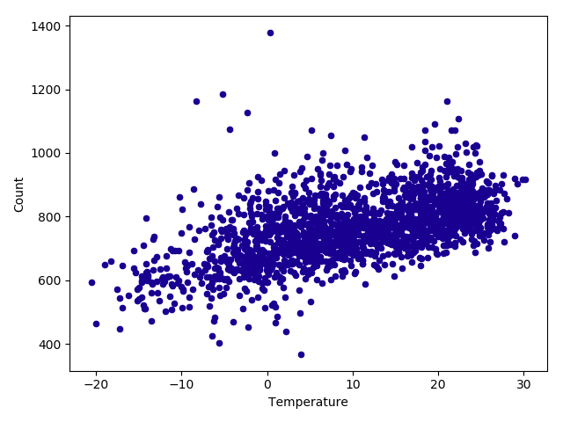
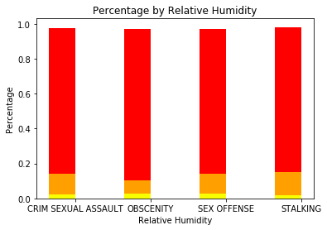
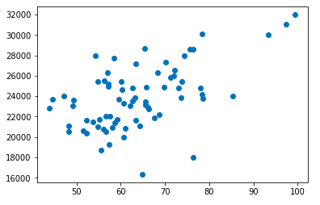
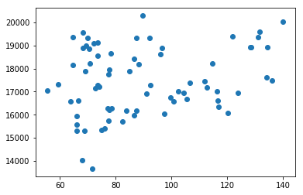

Factors that Affect Crime Rate in Major Cities
Shuang Ke, Xinrong Li, Yiwen Wang School of Information Sciences, University of Illinois at Urbana-Champaign
Introduction
Chicago is the most populous city in Illinois, it is famous for its fancy skyscrapers, and is also notorious for its high crime rates. The city's overall crime rate, especially the violent crime rate, is higher than the US average. Finding the causes of crime could be the most effective process to reduce the crime rate.
Additional to Chicago, we would also analyze other major cities such as Los Angeles, New York City. We would analyze the relationship between crime and weather factors(temperature, pressure, humidity etc.), as well as the relationship between crime and air pollution. By doing this analysis, we can compare and determine which factors have greater impact on each city.
Results
Weather
Temperature ￮ Humidity
Air Pollution
Chicago AQI ￮ Los Angeles AQI
Obvious positive linear correlation between the weather and the total count of crime per day
Red area means relative high humidity, there might be some association between the high humidity and the crime rate per day
Hypothesis
Temperature could be one of the factors that affect crime rate. The frequency of crime is relatively high in warm seasons and low in cold seasons.
Humidity might have different degrees of influence on different types of crime. It might has greater impact on sexual crime.
Air pollution could be one of the factors that affect crime rate. Server air pollution can trigger physical discomfort which could lead to antisocial behavior and induce aggression, thus increasing the crime rate.
Air pollution in Chicago might have greater impact on crime than Los Angeles does.
Method
Data parsing
Pandas Dataframe, join, groupby, aggregation
Correlation plot
Linear regression analysis
Higher AQI indicates more serious air pollution. When AQI went higher, the total count of crime per month went higher.
Compare to the result of Chicago, Los Angeles shows less correlation between AQI and crime rate.
Conclusions
There is a positive correlation between the frequency of crime and temperature. The higher the temperature, the larger the crime frequency.
Humidity has greater impact on sexual related crimes.
Server air pollution can lead to higher crime rate.
Acknowledgments
Shuang Ke, Xinrong Li, Yiwen wang.

